Slide 1

Introduction to Python for Data Science
Session 1 - Coding in Python
Developed by (Benjamin Frost in 2019) for City Data Science Society 2021

Slide 2
Introduction
Who are we?
Structure of the course
Week 1: Coding in Python
Week 2: Working with Data
Week 3: Machine Learning Algorithms
Week 4: Advanced Libraries & Class Project
Notes:
I’ve spent the last year completing qualifications and working with academics at City on research projects.

Slide 3
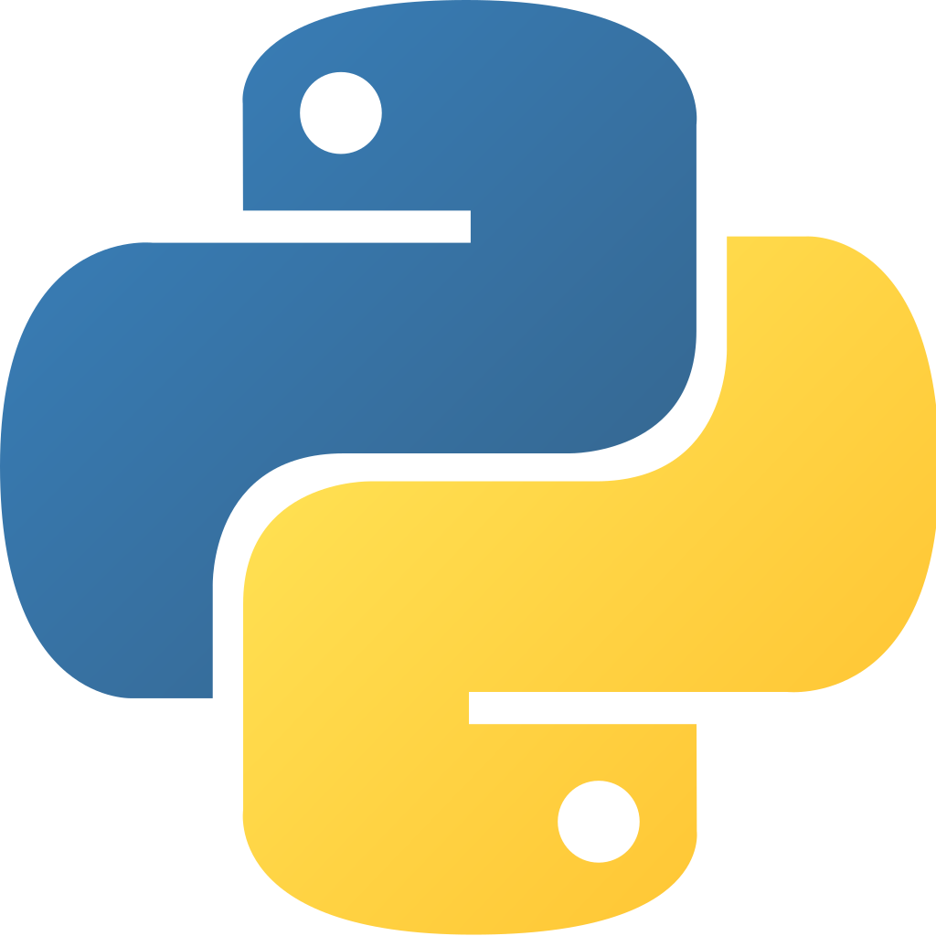
What is Python?
Python is a scripting language, used frequently for analytics.
Python 1.0 released in 1991
Python 2.0 released in 2000
Python 3.0 released in 2008
Not backwards compatible

Slide 4
Python’s Applications
Python is a highly modular programming language, meaning it can be used in a variety of applications. Such applications include:
Web development (Django)
Software development control and testing (Buildbot/Apache Gump)
Writing scripts to test newly created software to find bugs and edge cases
Desktop GUI applications (TkInter)
Python has a highly active online community, developing libraries and maintaining source code.

Slide 5
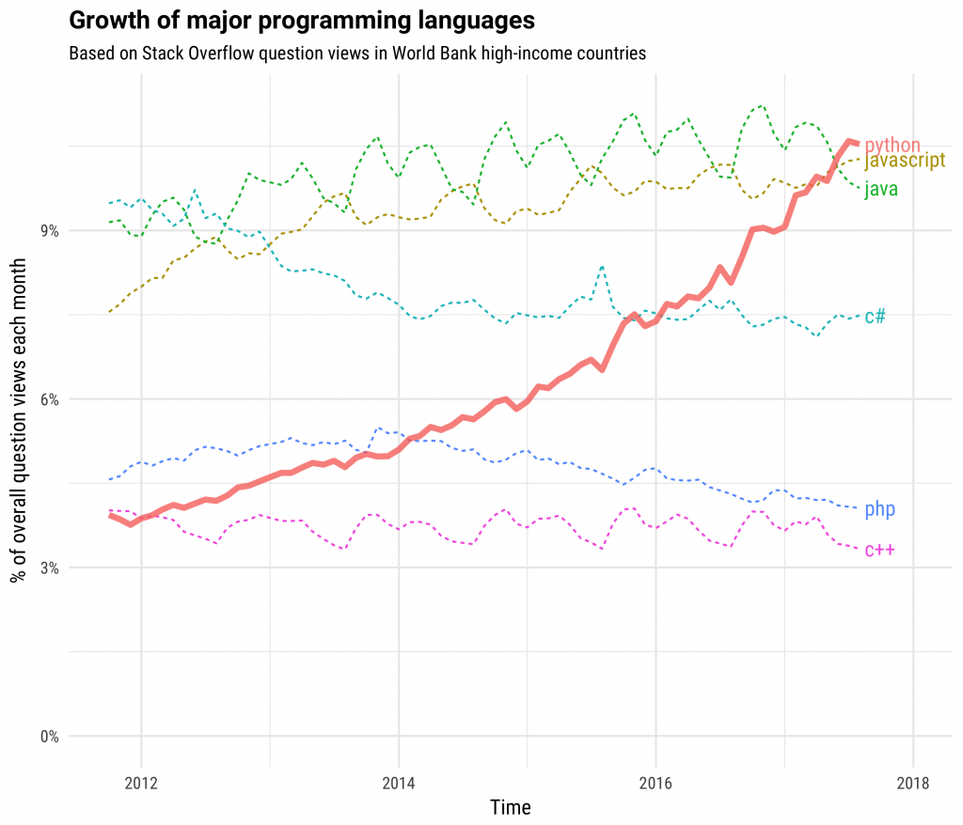
https://stackoverflow.blog/2017/09/06/incredible-growth-python/

Slide 6
Jupyter Notebooks
Used for learning Python as well as research and consepts.
Used for cleaning data and automating scripts.
Provides structure and clarity to code.
Code written in notebooks can be downloaded as a .py file for further development.

Slide 7
Download the project file from:
https://datasciencesociety.city
Upload it to:
https://jupyter.org/try

Slide 8
Machine Learning Concepts
Machine learning is an application of artificial intelligence
It is the concept of having a computer teach itself how to solve a problem.
Some types of machine learning algorithms include:
Neural networks
Polynomial Regression
Classification
Clustering

Slide 9
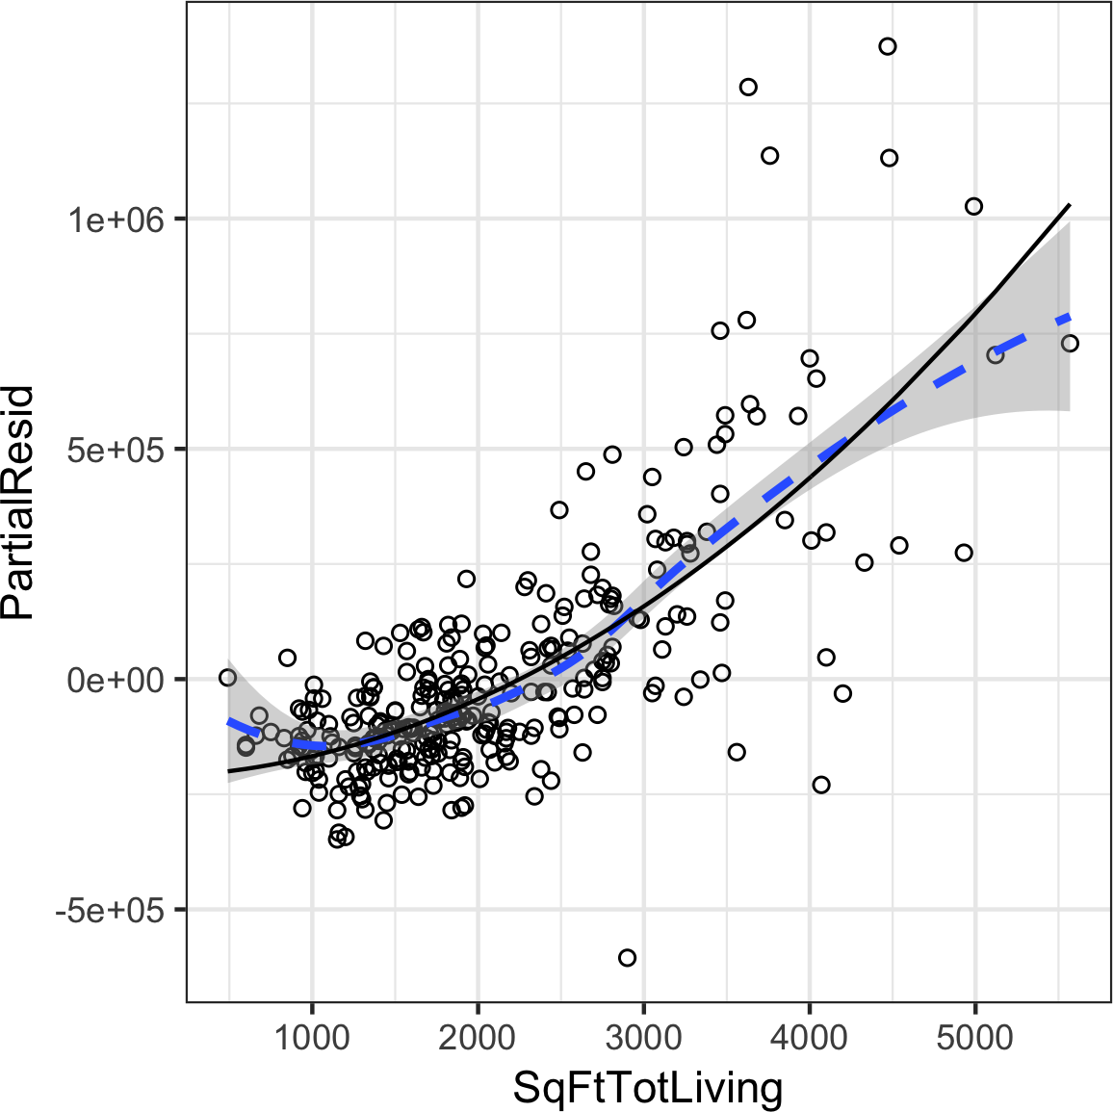
Example Application
Predicting financial trends given the trends from previous years.

Slide 10
Next Week:
Formatting data using Pandas dataframes.
Data Cleaning and why this is necessary.
Quantitative Vs Qualitative data
Weighting data.
Matplotlib and types of graphs.

